Slide 1
Computer Organization & Assembly Language (CSC-205)
Lecture 5
Data Transfer and Addressing

Slide 2
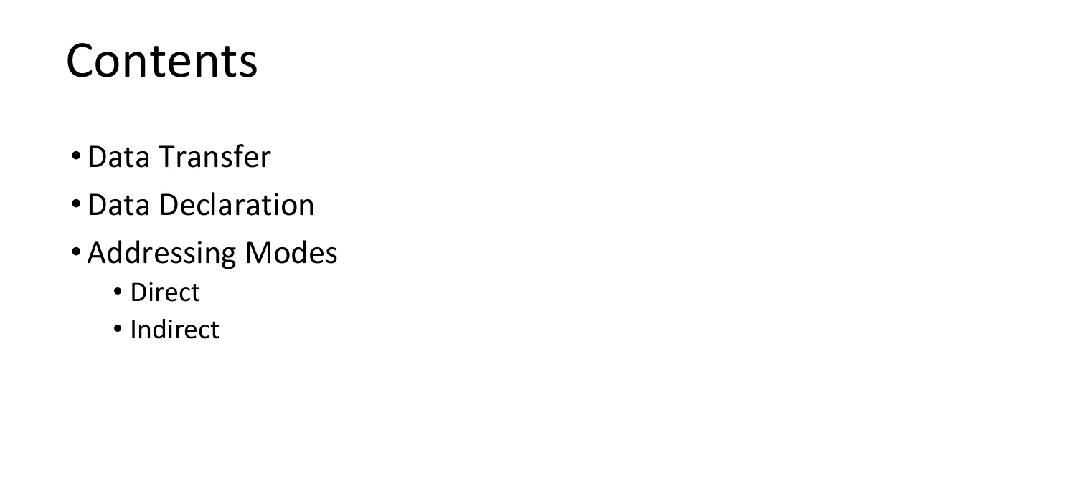
Contents of this Lecture

Slide 3
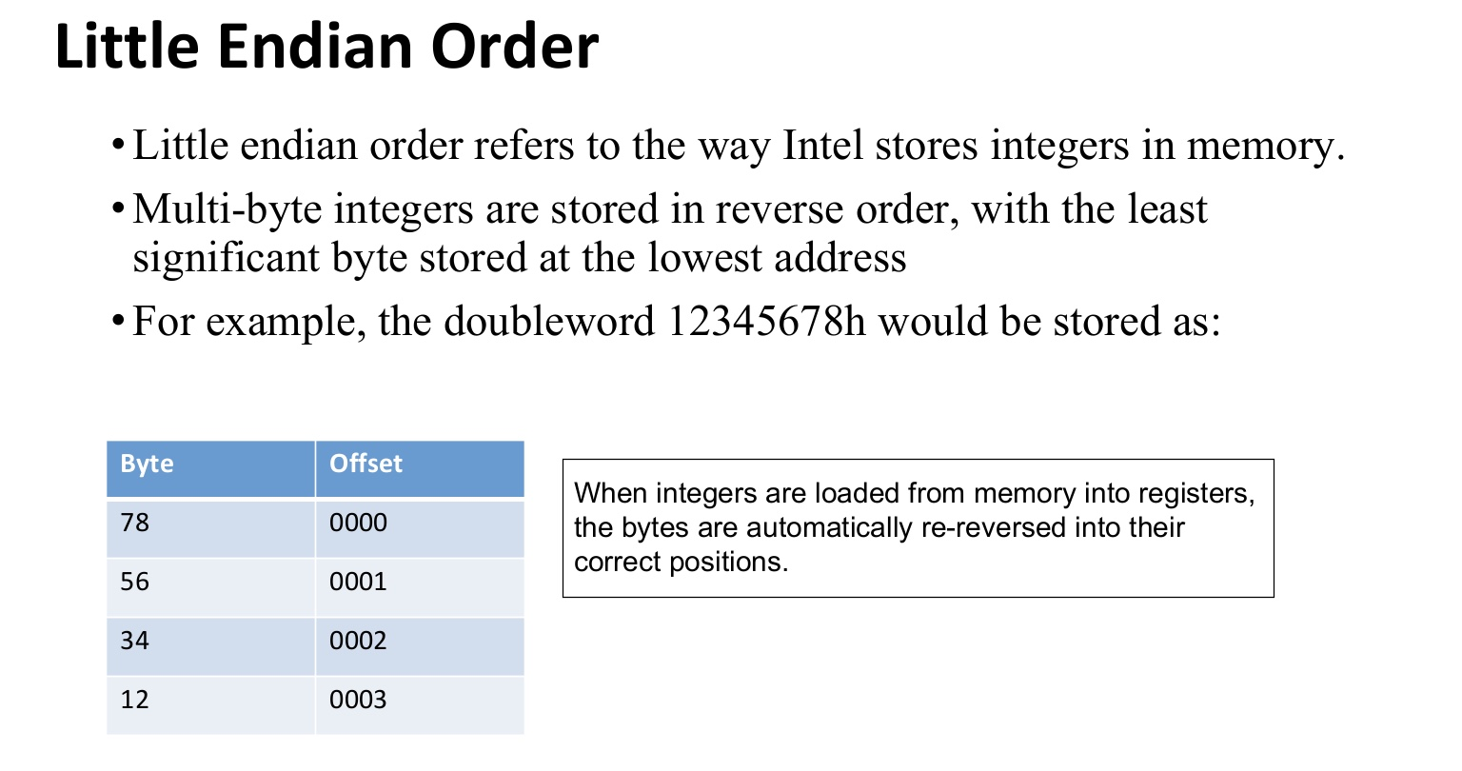

Slide 4
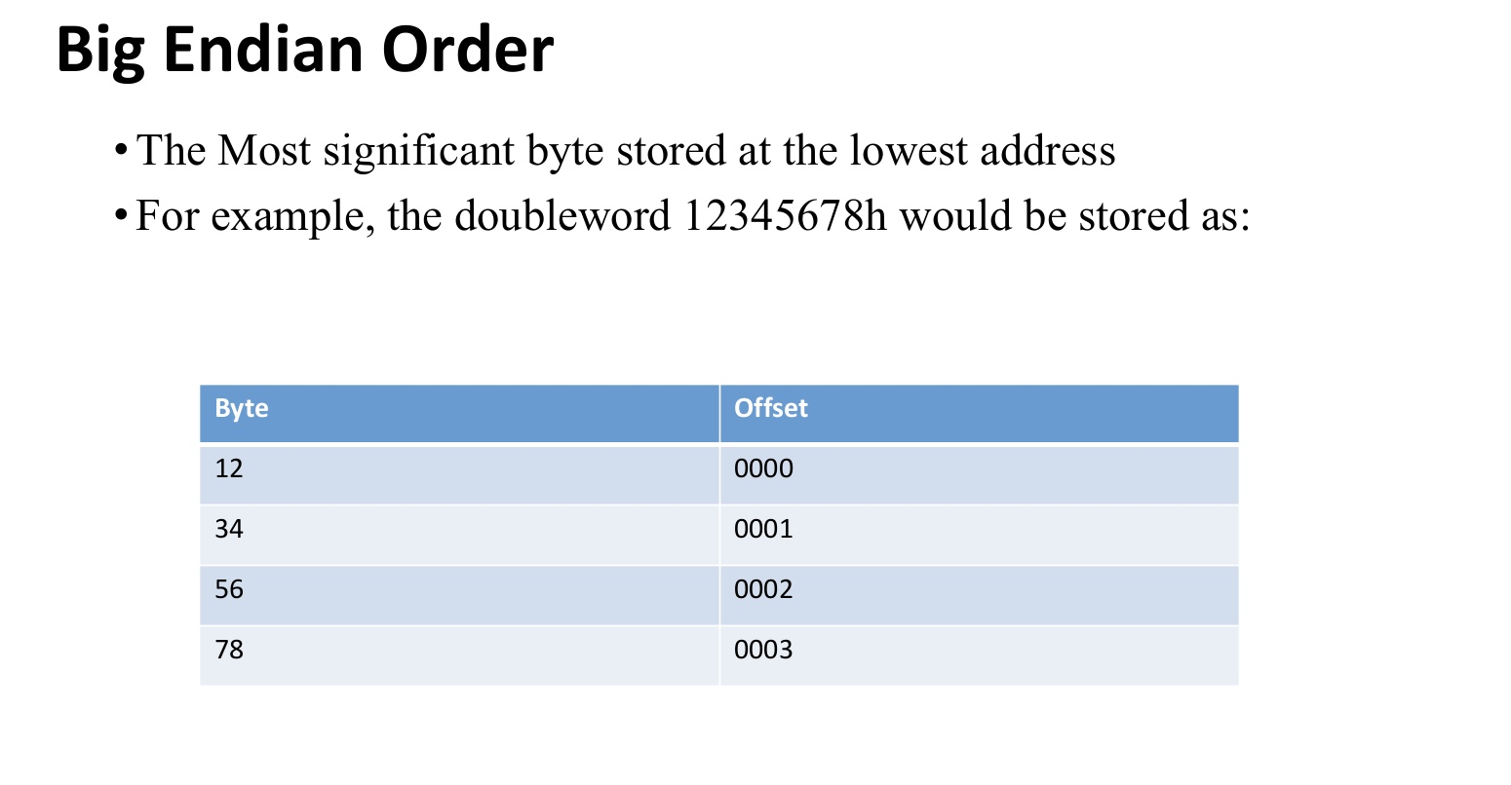
Notes:
ax(accumulator register), bx(base register),

Slide 5
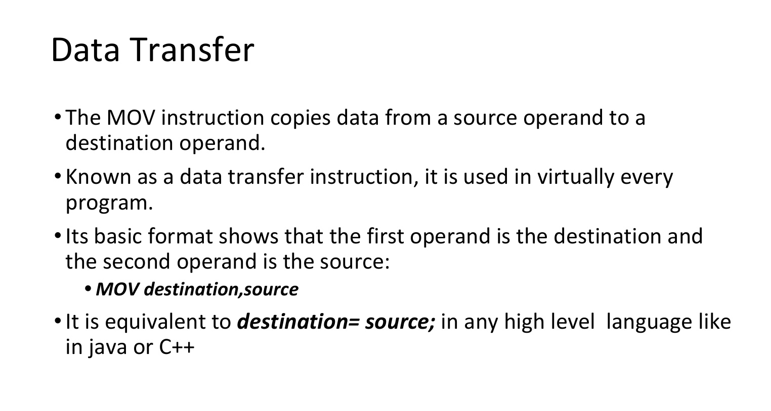
Data Transfer

Slide 6
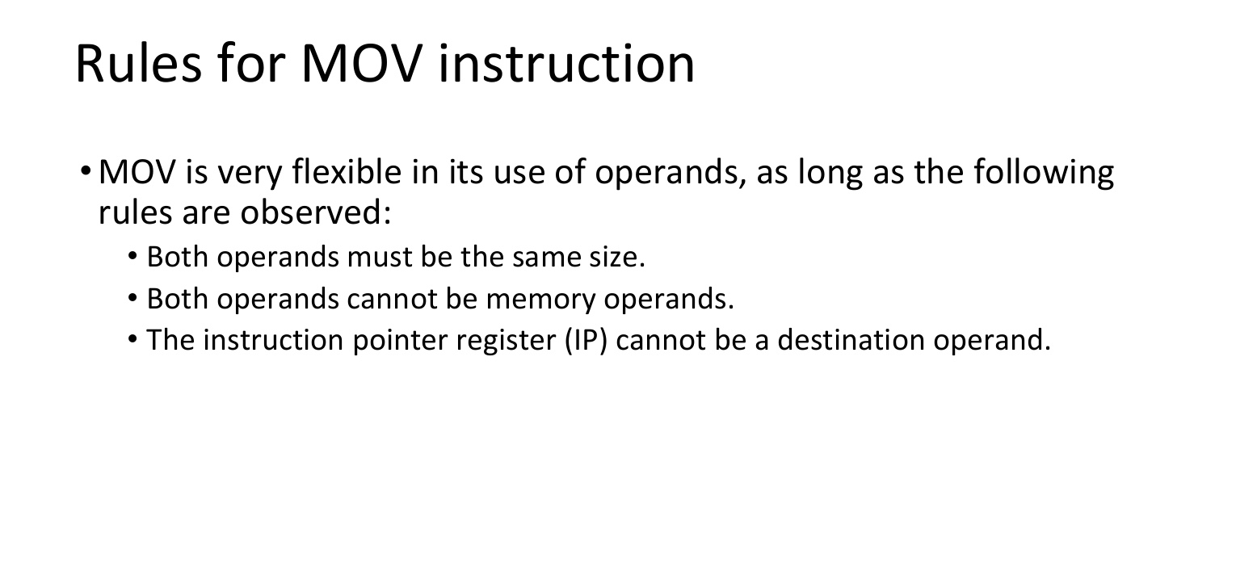
Rules for MOV

Slide 7
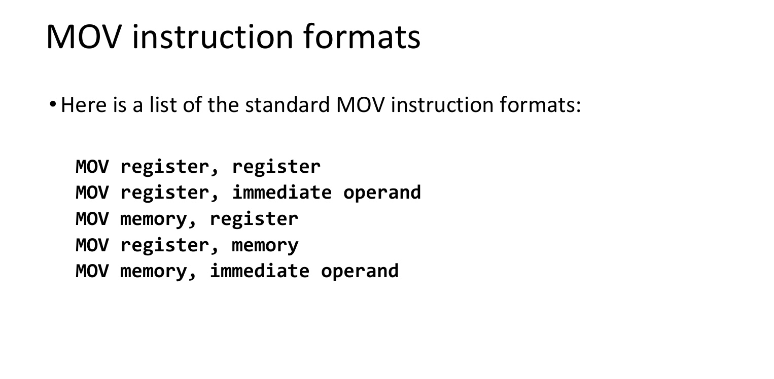

Slide 8
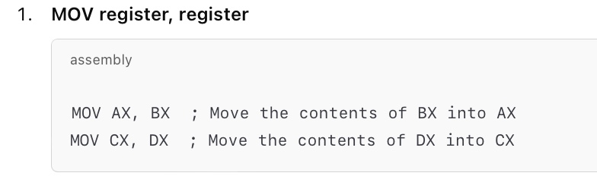

Slide 9
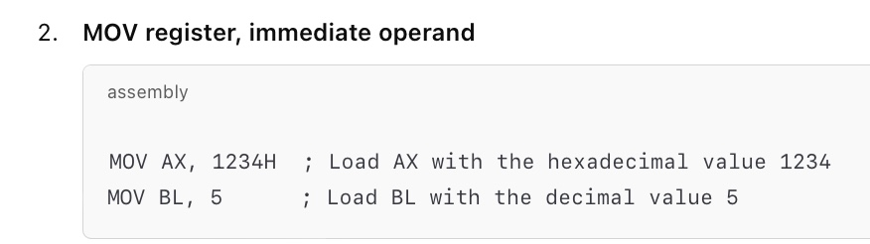

Slide 10
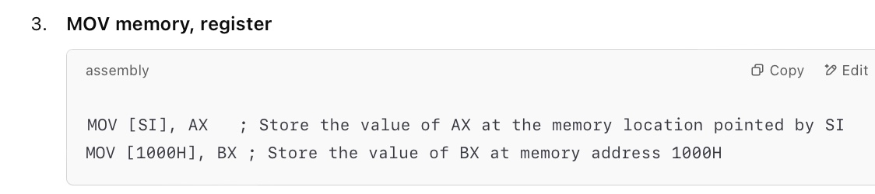

Slide 11
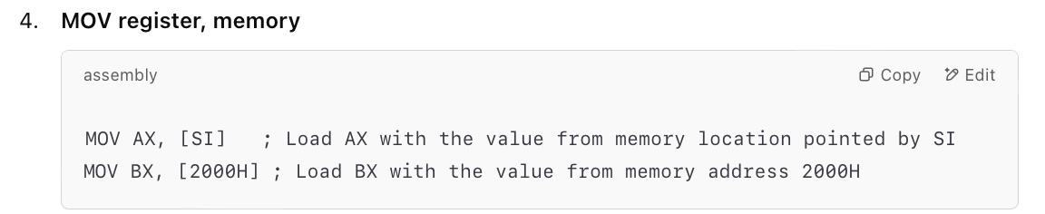

Slide 12
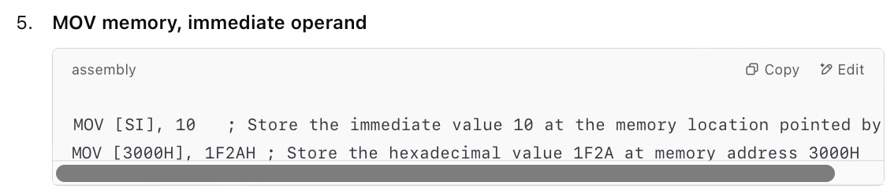

Slide 13
Example
Tell me the output at each line.
Mov ax, 1;
Mov bl, 0Ah;
Mov bl, 8FE2h;
Mov ah, 000010001b;
Mov ah, 10o;
Mov CX, AX;

Slide 14
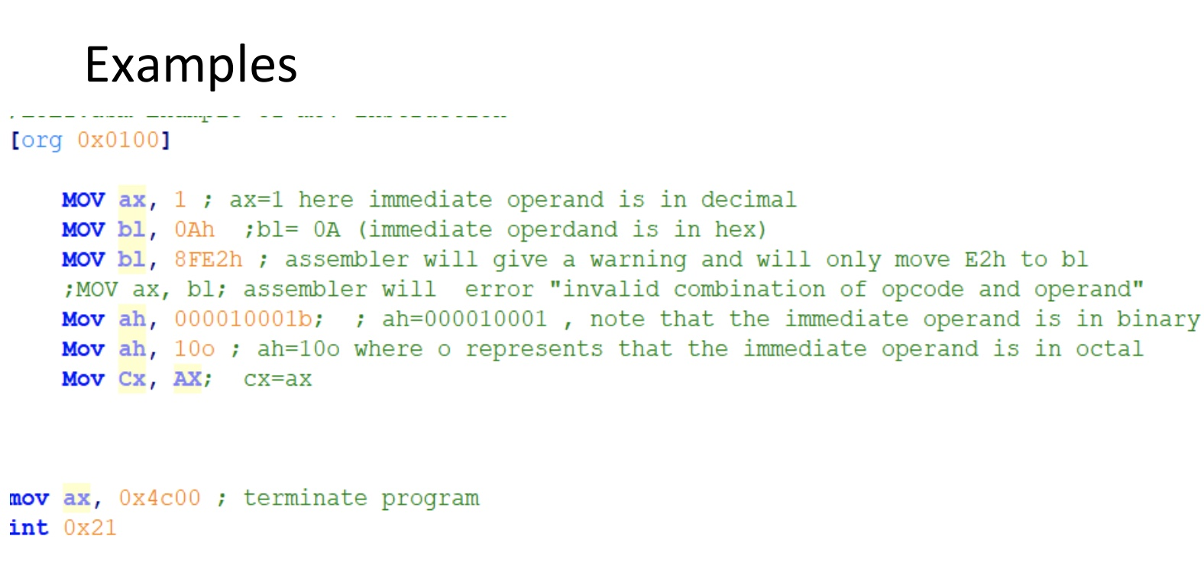
Example

Slide 15
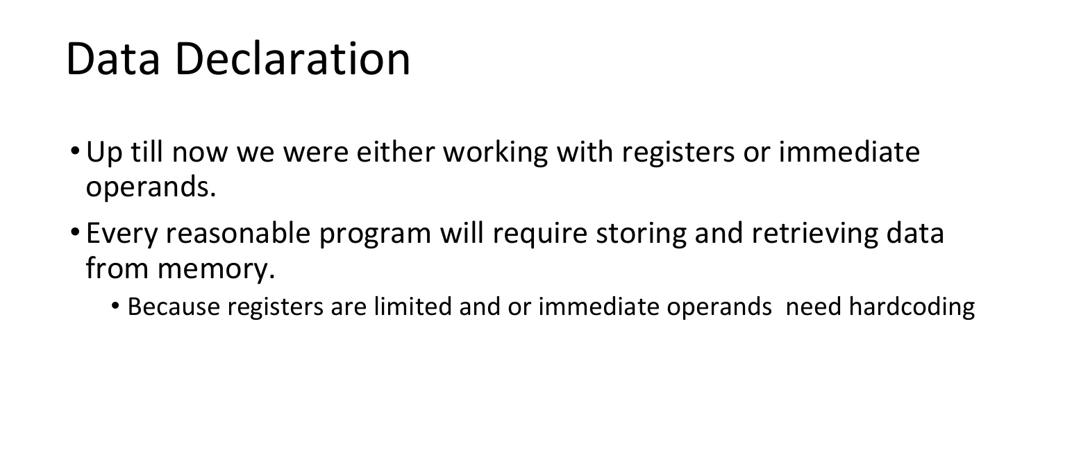

Slide 16
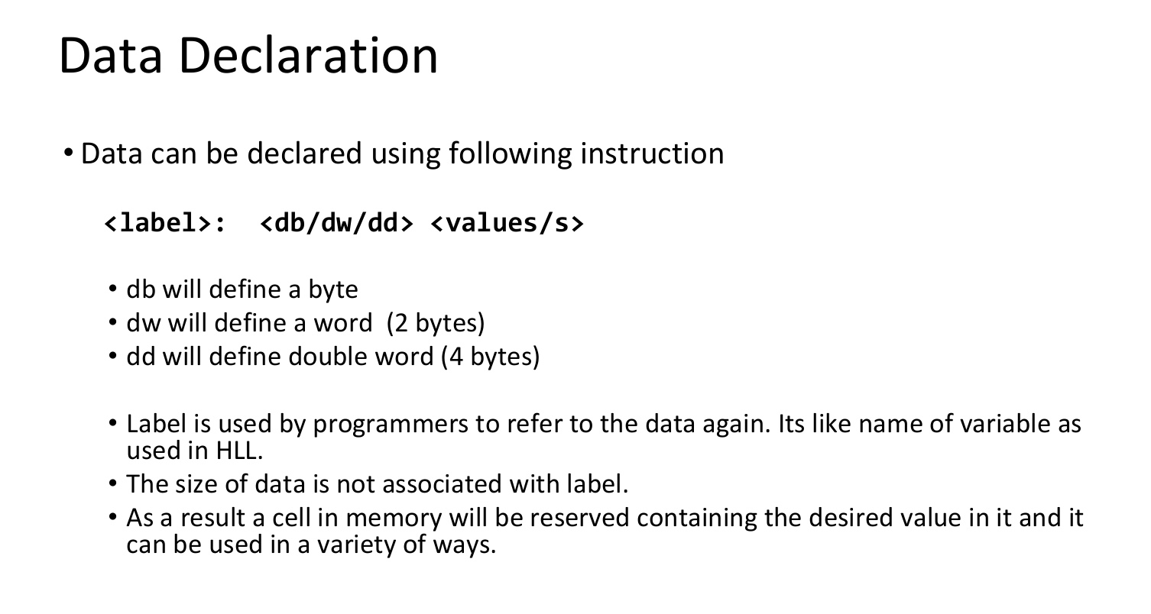
Data Declaractions

Slide 17
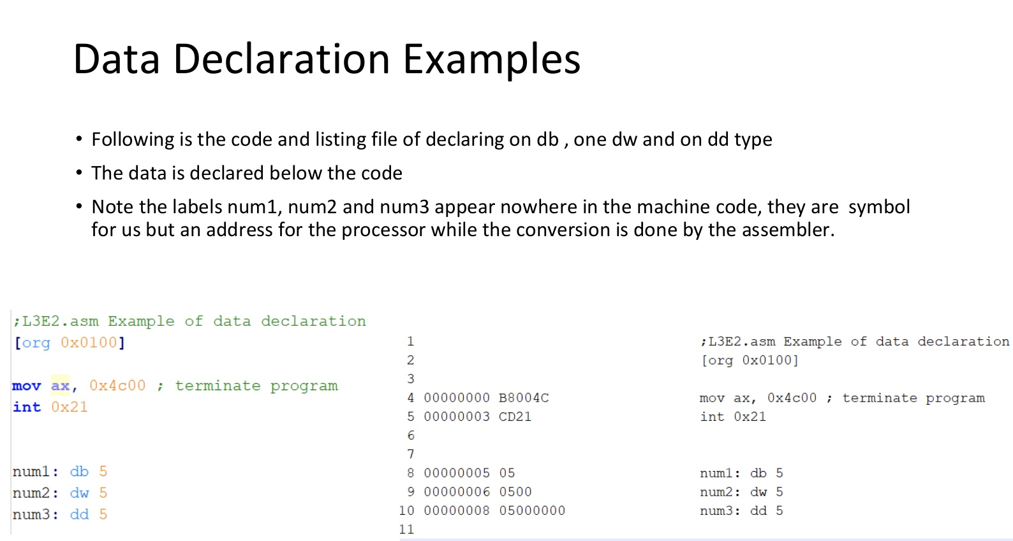

Slide 18
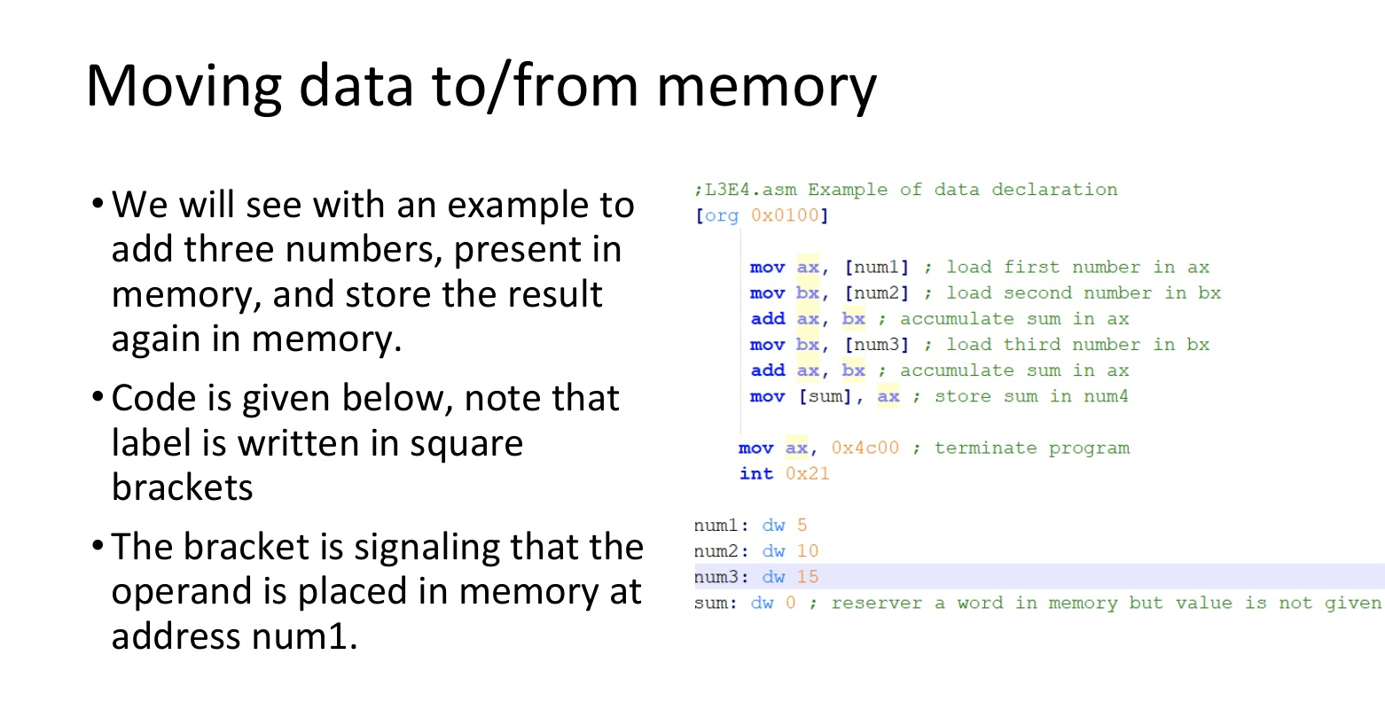

Slide 19
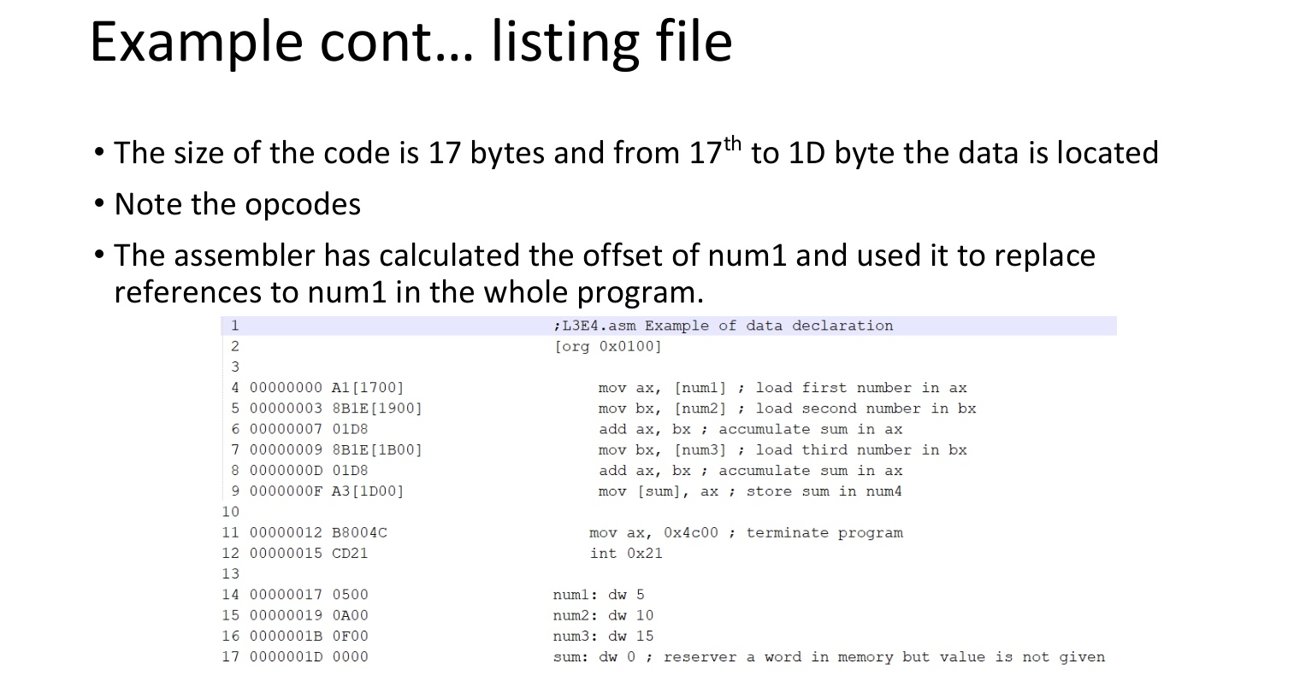

Slide 20
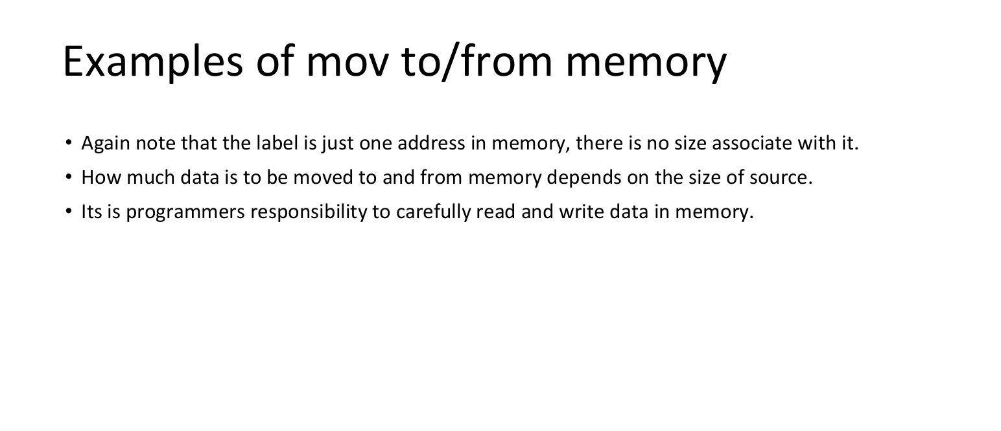

Slide 21
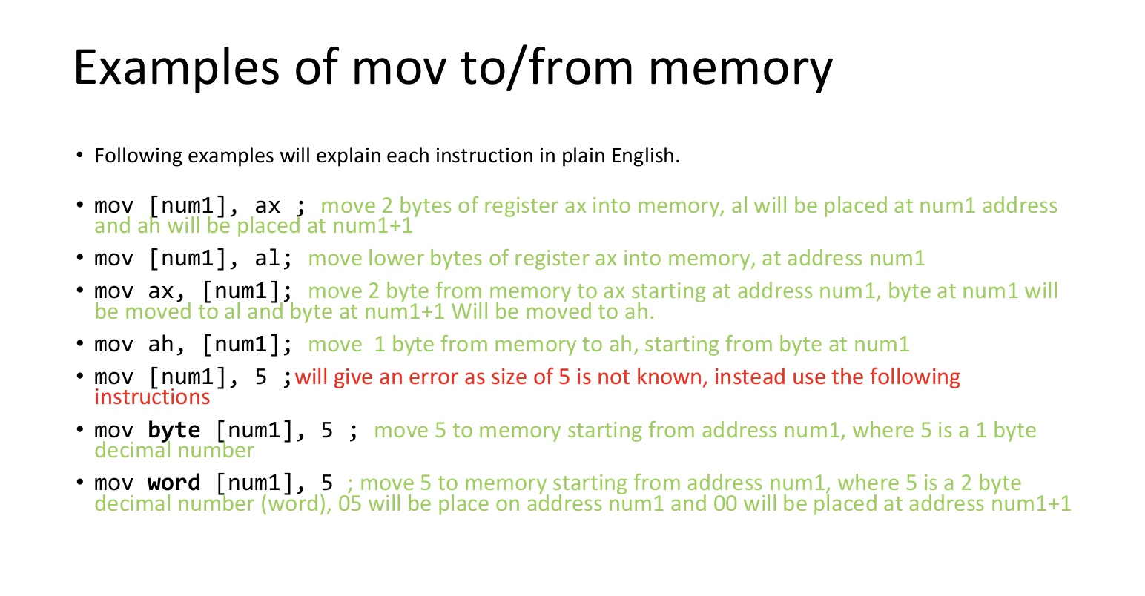

Slide 22
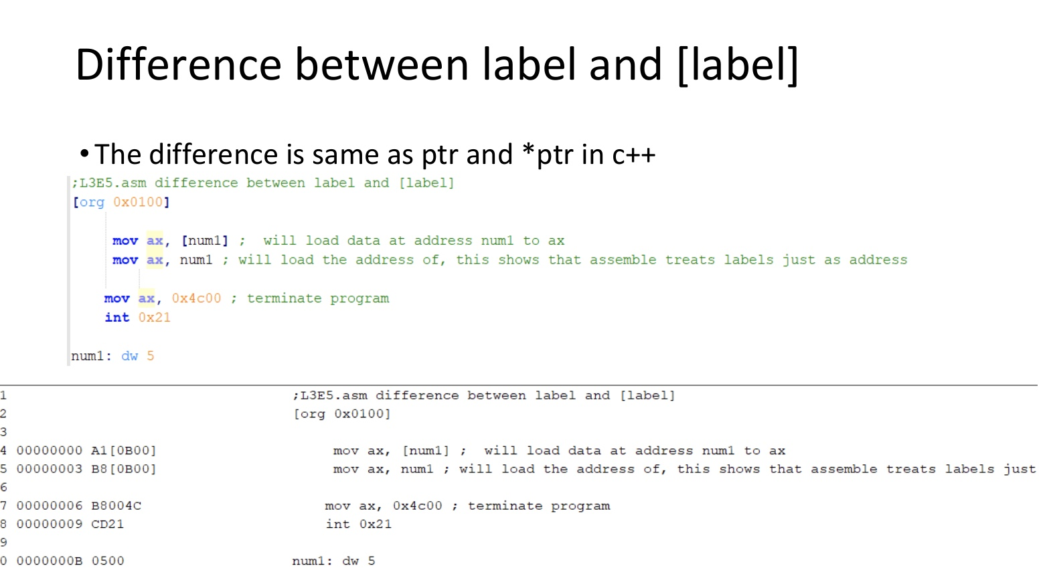

Slide 23
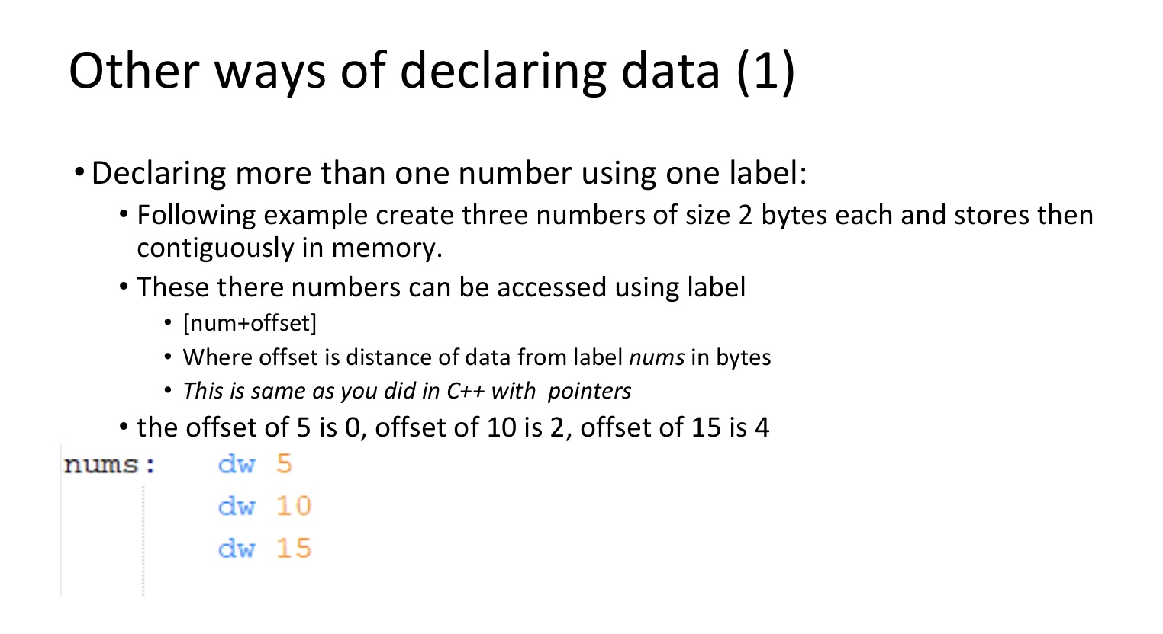

Slide 24
End of Lecture

